Slide 1


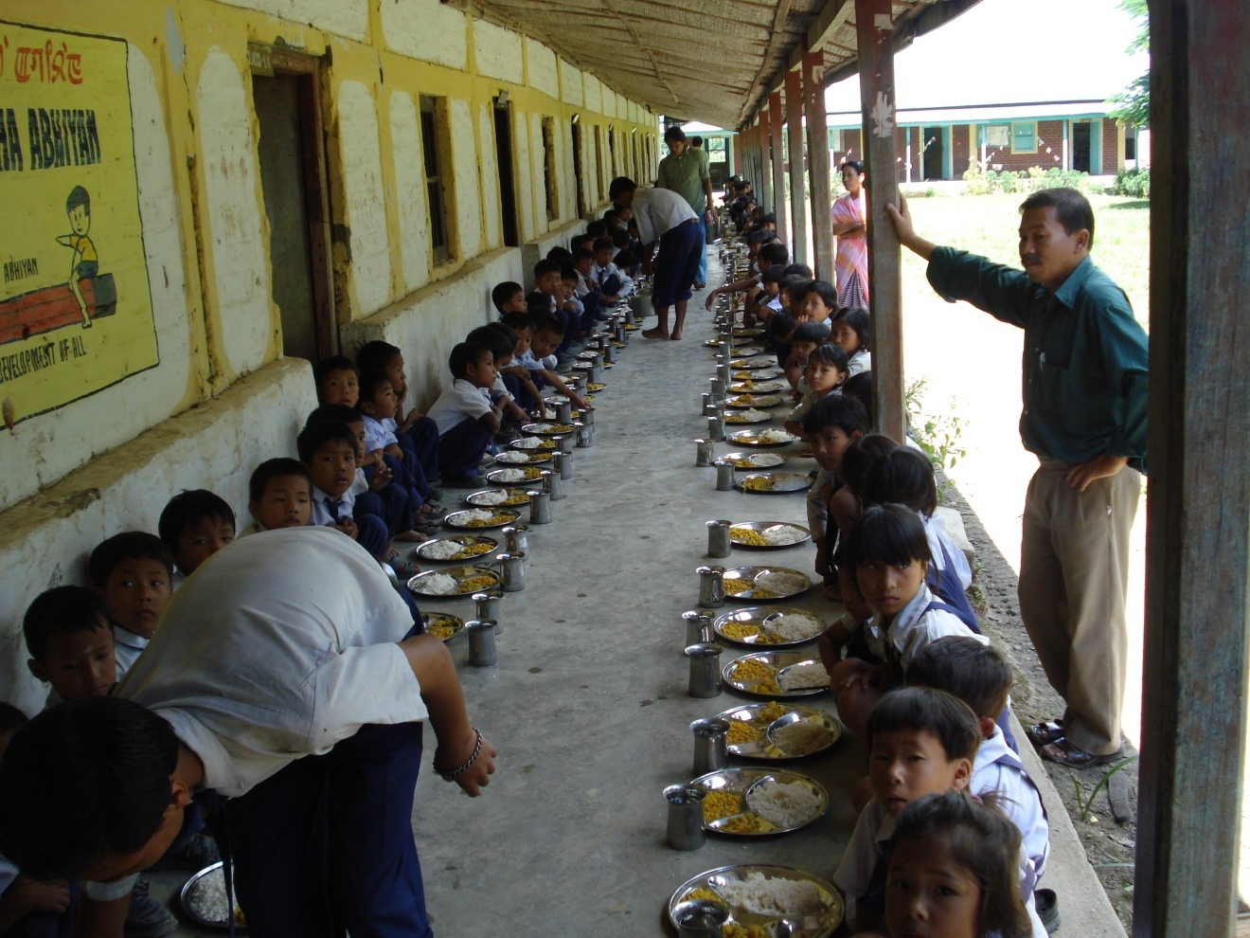
Mid Day Meal Scheme
MDM-PAB Meeting- Manipur
18.05.2018

Slide 2
Review of Implementation of MDMS in MANIPUR
(Primary + Upper Primary)
(1.4.2017 to 31.03.2018)
Ministry of HRD, Govt. of India

Slide 3
Good practices in Implementation
Participation by the Mothers / Parents/ Community members in implementation of the scheme.
Kitchen gardens in 154 schools.
Ministry of HRD, Govt. of India

Slide 4

Issues
Decline in coverage of children in primary and upper primary categories.
Less coverage of working days (218 out of 228).
Less coverage of institutions (90%).
Delay in release of funds from State to school level (10 months); Balance of 1st and 2nd instalments still not released by State to schools.
Construction work of 1883 (63%) units of the sanctioned kitchen cum stores is still under progress. No progress in FY 2017-18.
Use of firewood as mode of cooking in 91% schools.
Ministry of HRD, Govt. of India

Slide 5
Pending Issues
Restoration/revalidation of Rs.701.11 lakhs deducted on account of subsidy amount for construction of 1792 kitchen cum Store during 2011-12.
183 (new) units of kitchen devices sanctioned in FY 2016-17 and 1650(replacement) units sanctioned in FY 2017-18 however, funds not released to State due to want of physical and financial progress report of 1989 KD sanctioned earlier.
Ministry of HRD, Govt. of India

Slide 6

Innovations etc.
It is proposed that the States and UTs may also be given flexibility to utilize, with prior approval of MHRD, 5% of their Annual Work Plan & Budget for new interventions provided they are not included under any of the Central or State Schemes and there is no overlapping of activities. This is subject to CCEA approval.
Some of the suggested innovation may be in the field of Water filters, kitchen gardens, provision of LPG connections, use of millets etc. These are only illustrative and not exhaustive.
Community participation.
Meetings of District committee headed by Dist. Collector.

Slide 7
Coverage : Institutions :
Existing Vs Achievement (Pry)
No. of Institutions
90%
88%
88%
Ministry of HRD, Govt. of India

Slide 8
Coverage Institutions
Existing Vs Achievement (U. Pry)
No. of Institutions
98%
93%
95%
Ministry of HRD, Govt. of India

Slide 9

Coverage of Children (Primary )
National Avg – 76%
No. of Children (in lakh)
82%
85%
84%
Imphal West: 60%
Ministry of HRD, Govt. of India

Slide 10
Coverage : Children (Up. Pry)
National Avg – 76%
No. of Children (in lakh)
81%
86%
82%
Imphal West: 65%
Ministry of HRD, Govt. of India

Slide 11
AADHAR ENROLMENT
Total Enrolment | Number of children having Aadhaar | Number of children applied for Aadhaar | Number of children without Aadhaar | Number of proxy names deleted
186504 | 59282 (32%) |  | 127222 | 17800
81%
86%
82%
Ministry of HRD, Govt. of India

Slide 12

FOOD GRAIN : ALLOCATION vs UTILISATION
Quantity in Hundred MTs
91%
83%
67%
Ministry of HRD, Govt. of India

Slide 13
Payment of cost of Food grains to FCI
Cost of Food Grain (Rs. In Lakh )
100%
As per FCI there is pendency of Rs. 4.15 lakhs for 2017-18
Ministry of HRD, Govt. of India

Slide 14

COOKING COST: ALLOCATION vs UTILISATION
Rs in Crore
91%
83%
66%
Ministry of HRD, Govt. of India

Slide 15

Engagement of Cook-cum-helpers
No. of CCH
Primary + Upper Primary
87%
Ministry of HRD, Govt. of India

Slide 16
Payment of Honorarium to CCH
Rs. In Crore
74%
72%
87%
Figures denote only central share
Ministry of HRD, Govt. of India

Slide 17
MME : ALLOCATION vs UTILISATION
Rs in Lakh
98%
78%
59%
Ministry of HRD, Govt. of India

Slide 18

Transportation Assistance : Allocation vs Utilisation
Rs in Crore
72%
75%
76%
Ministry of HRD, Govt. of India

Slide 19

Construction of Kitchen cum Stores
Total Sanctioned: 2966
1883 units
Progress (in %)
1083 units
Ministry of HRD, Govt. of India

Slide 20
Achievement up to 2017-18 (Kitchen Devices)
3107 units
Progress (in %)
1989 units
Total Sanctioned : 5096* (3639 new + 1457 replacement) units
*1650 also sanctioned however funds not released as the State did not complete procurement of 1989 units earlier sanctioned
Ministry of HRD, Govt. of India

Slide 21

Summary of performance - Physical
Percentage %
Ministry of HRD, Govt. of India

Slide 22
Summary of performance – Financial
Percentage %
Ministry of HRD, Govt. of India

Slide 23
Coverage : RBSK
Details | Total Institutions | Children
Total in State | 3823 | 186504
Health Check-up | 3442 | 180372 (97%)
IFA Distribution | 2671 | 125149 (67%)
Deworming Tablets | 3725 | 186504 (100%)
Spectacles | Nil | Nil
Ministry of HRD, Govt. of India

Slide 24
Elements of Ayushman Bharat
Electronic Health Records
Electronic health record for each child
Upgrading skills of emergency care
Training on basic first aid for the teachers
School Health Promotion Activities
Provision of Services
Health Screening
Age appropriate learning for promotion of healthy behavior and prevention of various diseases
Delivered through school teachers trained as Health Ambassadors in coordination with health department staff.
Screening of children 30 identified health conditions for early detection, free treatment and management through dedicated RBSK mobile health teams
Iron Folic Acid (IFA) tablets, Albendazole administration will be provided by teachers through WIFS and National Deworming Day (NDD) programme respectively.
Provision of Sanitary Napkins.
Identification of malnourished and anemic children and appropriate referrals to PHCs and hospitals. The periodicity of such checkups may be increased.
Age appropriate vaccination.
Availability of potable drinking water.
Yoga and Meditation.

Slide 25

Availability of safe drinking water
Schools | No. of schools
Total Schools | 3442
Schools having drinking water facility | 1871
Schools having safe drinking water facility | 1663
Having water filtration facility | 1663
Membrane (UV + RO) | -
UV purification | -
Candle filter purifier | 1663
Activated carbon filter purifier | -
Ministry of HRD, Govt. of India

Slide 26
Comparison of data: MIS vs AWP&B

Slide 27
Automated Monitoring System

Slide 28
Three Year scorecard at a glance
FY : 2017-18
FY : 2015-16
FY : 2016-17

Slide 29
Analysis of State’s Proposal for 2018-19
Ministry of HRD, Govt. of India

Slide 30
Proposal for 2018-19 : Children (Primary)
No. of children (in lakhs)
PAB Approval 17-18
Enrolment
Availed MDM (12 months)
Proposed by State
Availed MDM in Q-1
Availed MDM in Q-4
Recommendation
Availed MDM in Q-2
Availed MDM in Q-3
Ministry of HRD, Govt. of India

Slide 31
Proposal for 2018-19: Children (Upper Primary)
No. of children (in Lakhs)
PAB Approval for 2017-18
Proposed by State
Availed MDM (12 months)
Recommendation
Availed MDN in Q-1
Availed MDM in Q-2
Availed MDM in Q-3
Enrolment
Availed MDM in Q-4
Ministry of HRD, Govt. of India

Slide 32

Proposals and Recommendations
S. No. | Component | PAB Approval 2017-18 | Proposal for 2018-19 | Recommendation
1 | Children (Pry) | 143000 | 121595 | 121595
2 | Children (U Pry) | 37688 | 33979 | 33979
3 | Working Days (Pry & Up. Pry) | Pry: 228 U. Pry: 228 | Pry: 227 U. Pry: 227 | Pry: 227 U. Pry: 227
4 | Kitchen cum Store | Nil | Nil | Nil
5 | Cook cum Helpers | 7487 | 7487 (No Additional) | 7487
6 | Kitchen Devices- New | Nil | Nil | Nil
7 | Kitchen Devices- Replacement | 1650* | Nil | Nil
8 | Notional Requirement of Central Assistance (Rs. In lakh) | 2738.22 | 2381.95 | 2381.95
Ministry of HRD, Govt. of India

Slide 33
Thank You
Ministry of HRD, Govt. of India

